Slide 1
Chapter 3: Information Representation
Characters
Notes:
Calculations aren’t useful until their results can be displayed in a manner that is meaningful to people.
We also need to provide a means for data input.
Thus, human-understandable characters must be converted to computer-understandable bit patterns using some sort of character encoding scheme.

Slide 2
Character Codes
Character codes evolved as computers evolved
Richer character codes evolved for larger computer memories and storage devices
Earliest computer coding systems used six bits
Binary-coded decimal(BCD) - one of the early codes
Used by IBM mainframes in the 1950s and 1960s
Notes:
As computers have evolved, character codes have evolved.
Larger computer memories and storage devices permit richer character codes.
The earliest computer coding systems used six bits.
Binary-coded decimal (BCD) was one of these early codes. It was used by IBM mainframes in the 1950s and 1960s.

Slide 3
Character Codes
BCD was extended to an 8-bit code:
Extended Binary-Coded Decimal Interchange Code (EBCDIC)
EBCDIC
supported upper and lowercase alphabetic characters
supported special characters, such as punctuation and control characters
EBCDIC and BCD - still in use by IBM mainframes
Notes:
In 1964, BCD was extended to an 8-bit code, Extended Binary-Coded Decimal Interchange Code (EBCDIC).
EBCDIC was one of the first widely-used computer codes that supported upper and lowercase alphabetic characters, in addition to special characters, such as punctuation and control characters.
EBCDIC and BCD are still in use by IBM mainframes today.

Slide 4
Character Codes
ASCII (American Standard Code for Information Interchange)
7-bit code
Chosen by other computer manufacturers
BCD and EBCDIC - based on punched card codes
ASCII - based on telecommunications(Telex) codes
Until recently - ASCII was the dominant character code outside the IBM mainframe world.
Notes:
Other computer manufacturers chose the 7-bit ASCII (American Standard Code for Information Interchange) as a replacement for 6-bit codes.
While BCD and EBCDIC were based on punched card codes, ASCII was based upon telecommunications (Telex) codes.
Until recently, ASCII was the dominant character code outside the IBM mainframe world.

Slide 5
Character Codes
Unicode
16-bit system that can encode the characters of every language in the world
Java programming language and some operating systems now use Unicode as their default character code
Unicode codespace - Divided into six parts
First part is for Western alphabet codes
Includes ASCII
Contains characters for English, Greek, and Russian
Notes:
Many of today’s systems embrace Unicode, a 16-bit system that can encode the characters of every language in the world.
The Java programming language, and some operating systems now use Unicode as their default character code.
The Unicode codespace is divided into six parts. The first part includes ASCII and is for Western alphabet codes. It contains characters for English, Greek, and Russian.

Slide 6
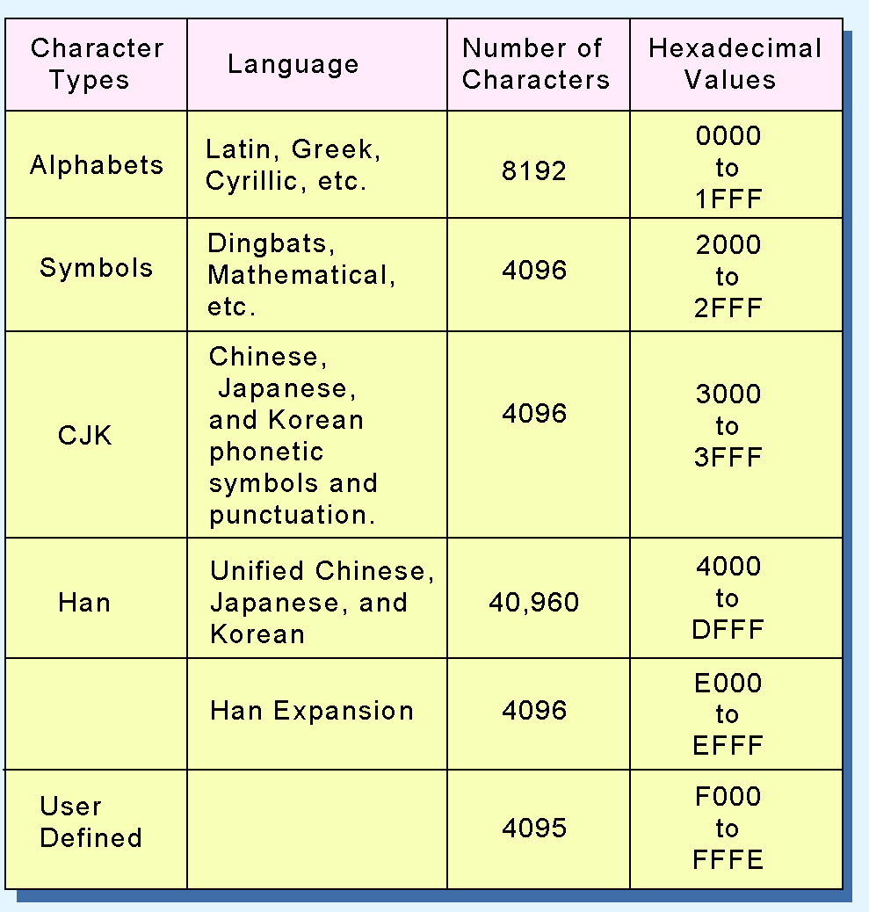
Character Codes
Unicode codespace allocation is shown at the right.
Lowest-numbered Unicode characters comprise the ASCII code
Highest character types provide for user-defined characters
Notes:
The Unicode codespace allocation is shown in this chart.
The lowest-numbered Unicode characters comprise the ASCII code.
The highest provide for user-defined codes.
One needs to be careful when using character codes. A character that is legal for one system may cause problems for another.
Once, in an old IBM ERP system, we decided to use a ~ tilde at the beginning of a description to indicate (to humans) that a part was not ready to be used.
About a week after the tilde was introduced, an IT mainframe person stormed into my office and asked who had put a tilde in several descriptions.
It turns out that the tilde character code was a reset code for a label printer and when that description was passed to the printer, it reset itself!
It had taken several days to determine what was wrong with the printer. Needless to say the tilde was removed and replaced by a more benign character.
It is very important that humans and computers understand the codes that are sent to them.

